Slide 1

EPL448: Data Mining on the Web Real or Not? NLP with Disaster Tweets. Predict which Tweets are about real disasters and which ones are not
Sotiris Loizidis
Marcos Antonios Charalambous
Dept. of Computer Science

Slide 2
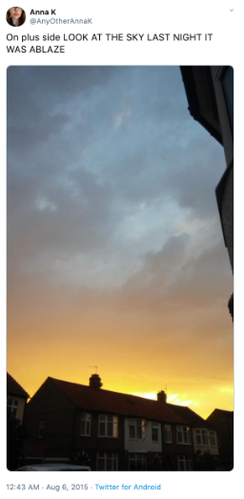
The Competition
Competition link: https://www.kaggle.com/c/nlp-getting-started
Is it a disaster tweet or not?
The tweet’s author explicitly uses the word “ABLAZE” but means it in a metaphorical sense. This is clear to a human right away, especially with the visual aid. But it’s less clear to a machine. (Taken from the Kaggle competition front page.)

Slide 3
Attention areas
Goals
Mine meaningful data from a given unprocessed dataset in order to design a model that will yield the best mapping between tweets and their class. (1 = Disaster, 0 = Irrelevant)
Methodology
Explore the dataset, which is a case of binary classification, using Exploratory Data Analysis techniques.
Explore various machine learning models appropriate for Natural Language Processing and find the one that performs best on our data.
Performance-wise, our goal was to achieve a confident accuracy improvement from a baseline null accuracy.
Analyze the results obtain by EDA and perform the suitable Data preprocessing on the dataset.
Optimize that model using parameter tuning, feature selection, train-test-split optimal ratios, k-cross validation)

Slide 4
Course of action
Study similar work from past competitions on Kaggle and various other sources regarding NLP on tweets.
Type of the problem
Understand and modify dataset as best as possible
Exploratory Data Analysis (EDA)
Data Preprocessing
List candidate models
Explore candidate ML models used in NLP
Perform test executions
Validate and Optimize the one that performs best on our dataset.
K-cross validation
Parameter hyper tuning
Feature Selection

Slide 5
Code Analysis
Code Analysis for our main file disasters.py
Data preprocessing & EDA ~ 550 L.O.C
Dataset splitting, various ML models training, k-cross validation and prediction ~ 440 L.O.C
We can see that code-wise, Data preprocessing and EDA require the most intensive coding. This is known fact for NLP problems.
Finding a model that just works is easy.
Finding a model that performs best is an extremely hard procedure and very time consuming.

Slide 6
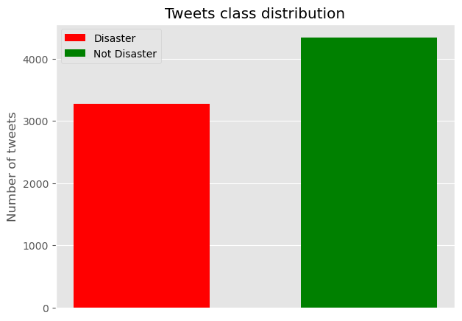
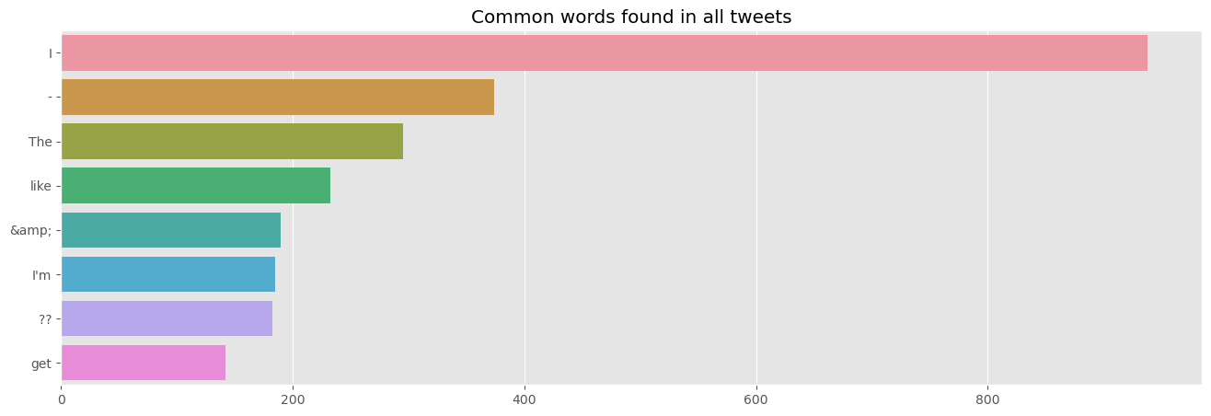
Exploratory Data Analysis
Some basic EDA first to inspect our dataset before we try various ways to process it.
We start by checking the class distribution of our data. As we can see from the figure, there are only two classes in our data. our subjects are at an about 43/57 split in favour of irrelevant tweets.
We also plotted the common words found between the two classes. There are many punctuations and stopwords among the top.

Slide 7
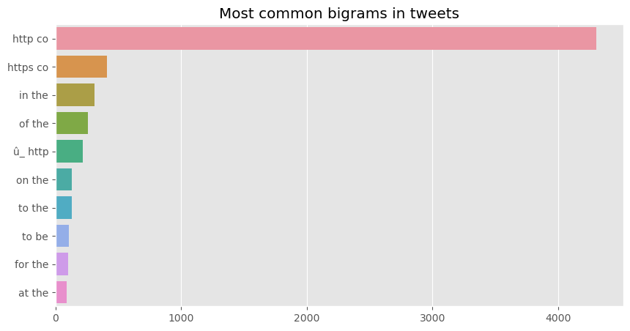
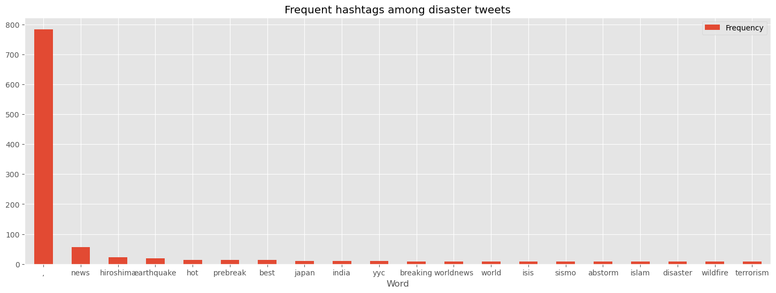
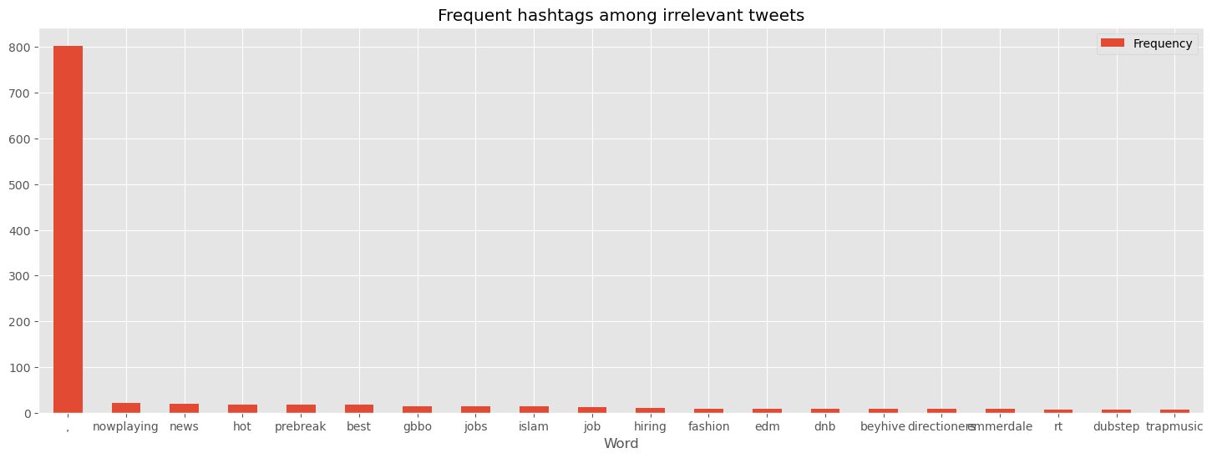
Exploratory Data Analysis (2)
Moreover we performed some bigram analysis over the tweets. We can se that the most frequent ones refer to websites or they are combination of stopwords. These provide no useful information.
In addition, we plotted the most common hashtags for both classes. It seems that for both classes we find some hashtags that are out of context.
Lots of cleaning needed!

Slide 8
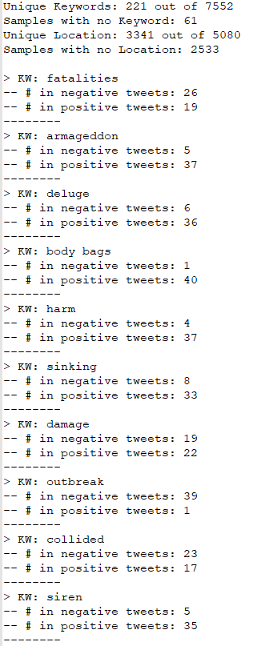
Keyword & Location

Slide 9
Data preprocessing
Notable techniques used during this phase:
Expand contractions to their original form, which helps with text standardization.
Hashtag expansion with the help of the ekphrasis module. Hashtags can provide valuable information about the class of the tweet.
Remove mentions that start with the character @, as they do not add value for building a disaster classification model.
Convert abbreviations found in tweets to its expanded form. For example, “brb” will be expanded to “be right back”.
Lemmatization, unlike Stemming, reduces the inflected words properly ensuring that the root word belongs to the language. A module named spaCy was used for advanced NLP processing.
Stripping HTML tags. HTML encoding may not be converted to text and end up in the text field as “&amp” which means “&”. We used the BeautifulSoup module for this.
Removing URLs. Dealing with URL links, same with @mention, even though it carries some information, for the disaster classification analysis purpose, this can be ignored.
Remove any stop words found, such as “the”, “for” and “at” (Which later we proof that this worsens the performance).
Other techniques worth mentioning are: unescaping Tweets, removing accented characters, replacing special characters, converting to lowercase, remove remaining whitespace characters, remove any punctuations and removal of emojis

Slide 10
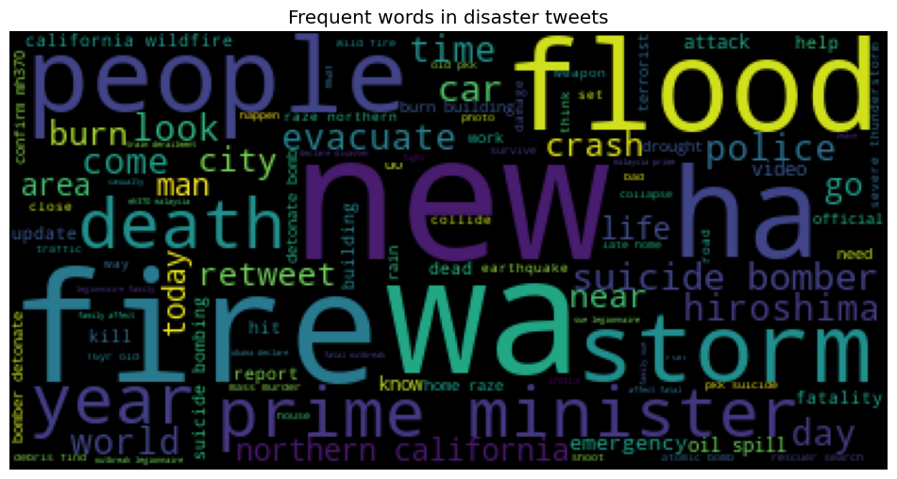
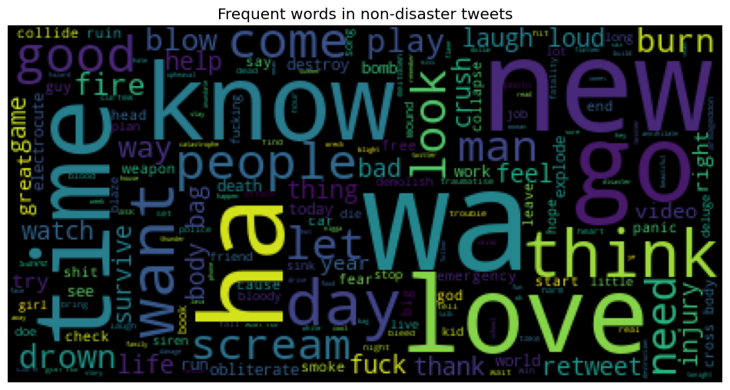
Results

Slide 11
Choosing the right word embedding
Before we even start to train our model, we need a way to convert our words in a way that a ML algorithm can understand and process it. Basically, we need to convert the text to numbers.
The two dominant candidates for doing this job and are used extensively in Natural Language Processing problems are:
Count Vectorizer: Associates an index to each word in our vocabulary, and embeds each sentence as a list of 0s, with a 1 at each index corresponding to a word present in the sentence.
TF-IDF: Weighing words by how frequent they are in our dataset, discounting words that are too frequent, as they just add to the noise.

Slide 12
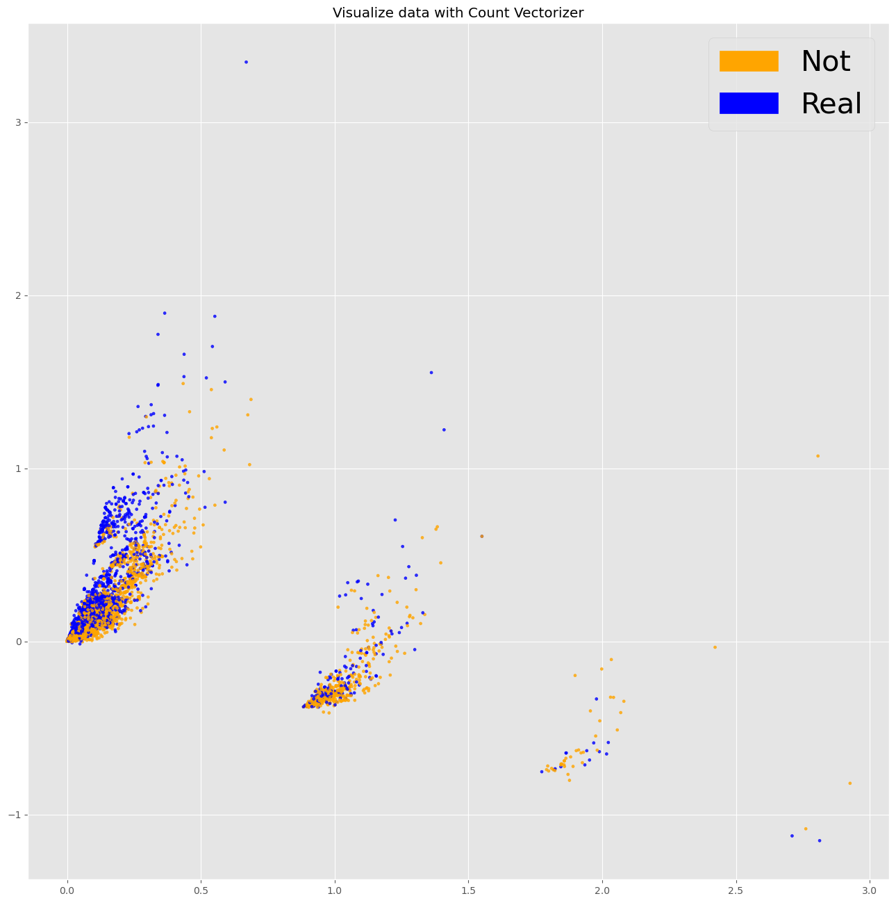
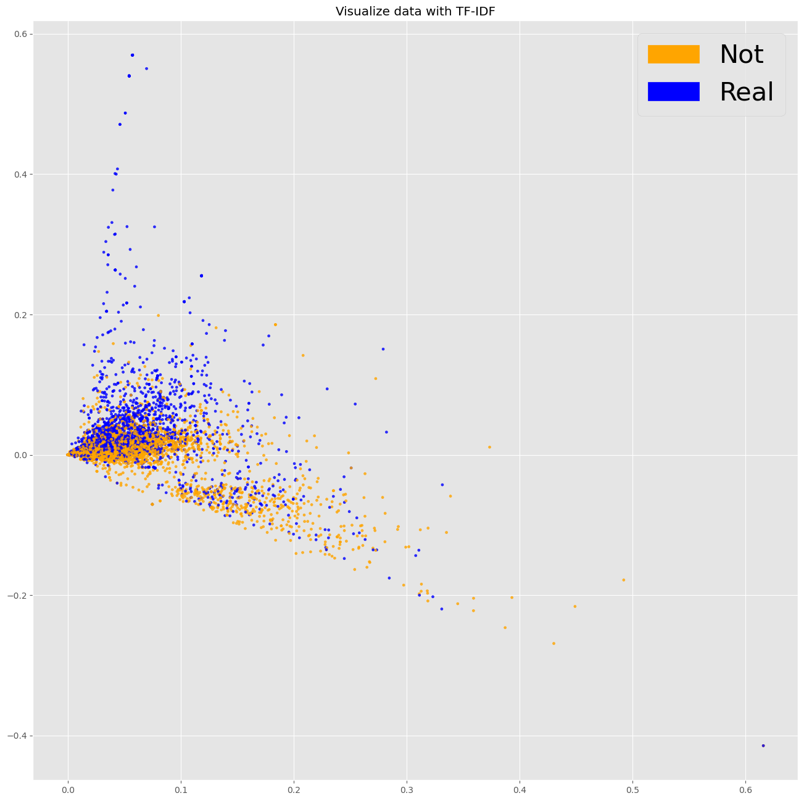
Latent Semantic Analysis
After we have created the word embeddings, we visualize them and see if we can identify some structure. In a perfect world, our embeddings would be so distinct that are two classes would be perfectly separated. Regardless of the number of dimensions we project our data to two dimensions representing the two tweet classes that exist. With TF-IDF, the embeddings look more separated.

Slide 13
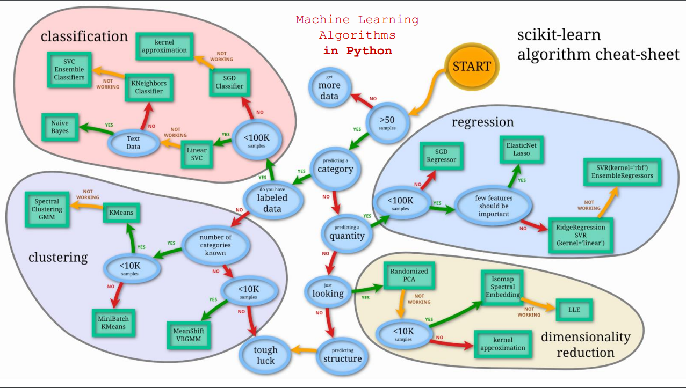
Model Understanding

Slide 14
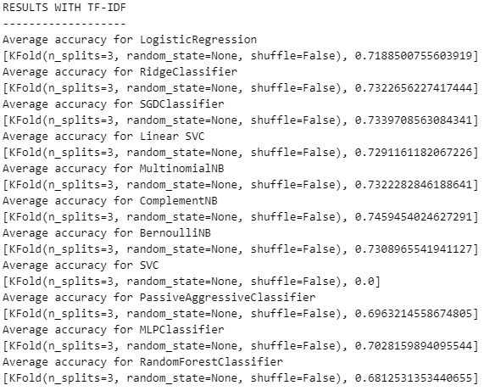
K-Cross Validation
K-cross Validation was executed on all phases of the process.
A loop was constructed to study the different models under a range of 3 to 10 k-folds. Screenshot displays the result for kfold=3.
Nevertheless, after selecting the model that performed best across different values of folds and yielded the optimal results in a stable manner, we moved on with our experiments with the recommended number of folds which is 10.
Choosing the most trustworthy model which is the Logistic Regression instead of a variation of Naïve Bayes.
Ultimately, upon submission to the online competition our instincts where proven correct.
Optimizing best model using the Grid Search technique.

Slide 15
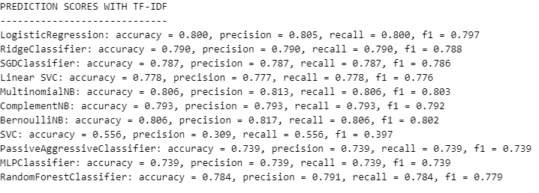
Model Selection
After experimenting with both an 80-20 and an 85-15 split we realised that the extra 5% given to the train set boosted our prediction scores. Logical outcome since our dataset is small.
Candidates that stand out from the rest:
Linear Regression
Variations of the Naïve Bayes classification algorithm.

Slide 16
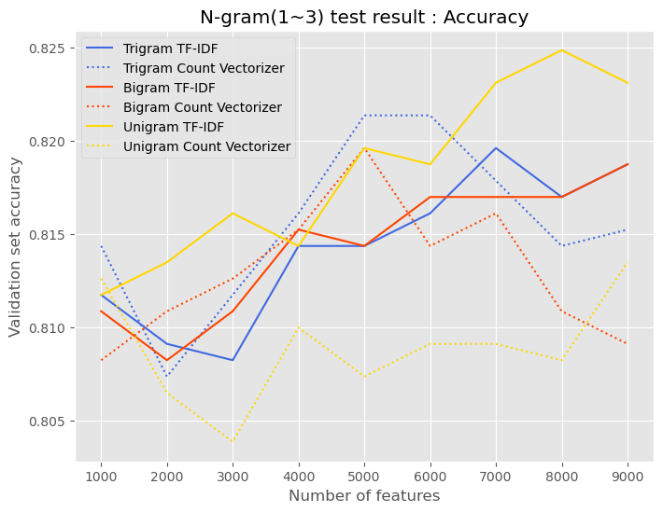
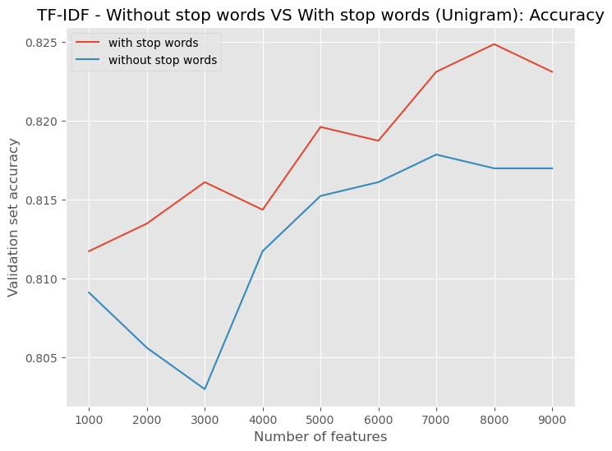
Optimizations
Using unigrams with combination of TF-IDF we yield the best results.
Careful study of our EDA and tinkering with our data pre processing procedure for optimal results we can see that using the Logistic Regression model without removing the stop words we gained more accuracy.

Slide 17
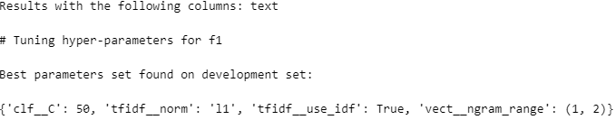
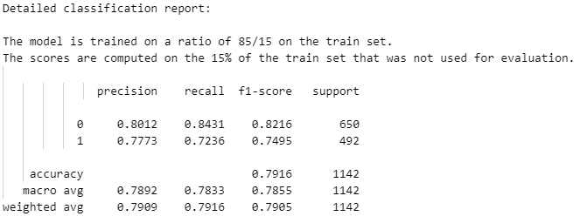
Parameter hypertuning
Exhaustive Parameter Search on our best model to find the optimal parameter combination for it.
Not the results we were expecting. ☹
Best scores were ultimately achieved using default parameters.
We opted not to use a fixed splitting in our test because it is our firm belief that keeping the splitting random provides a more spherical understanding of the problem.

Slide 18
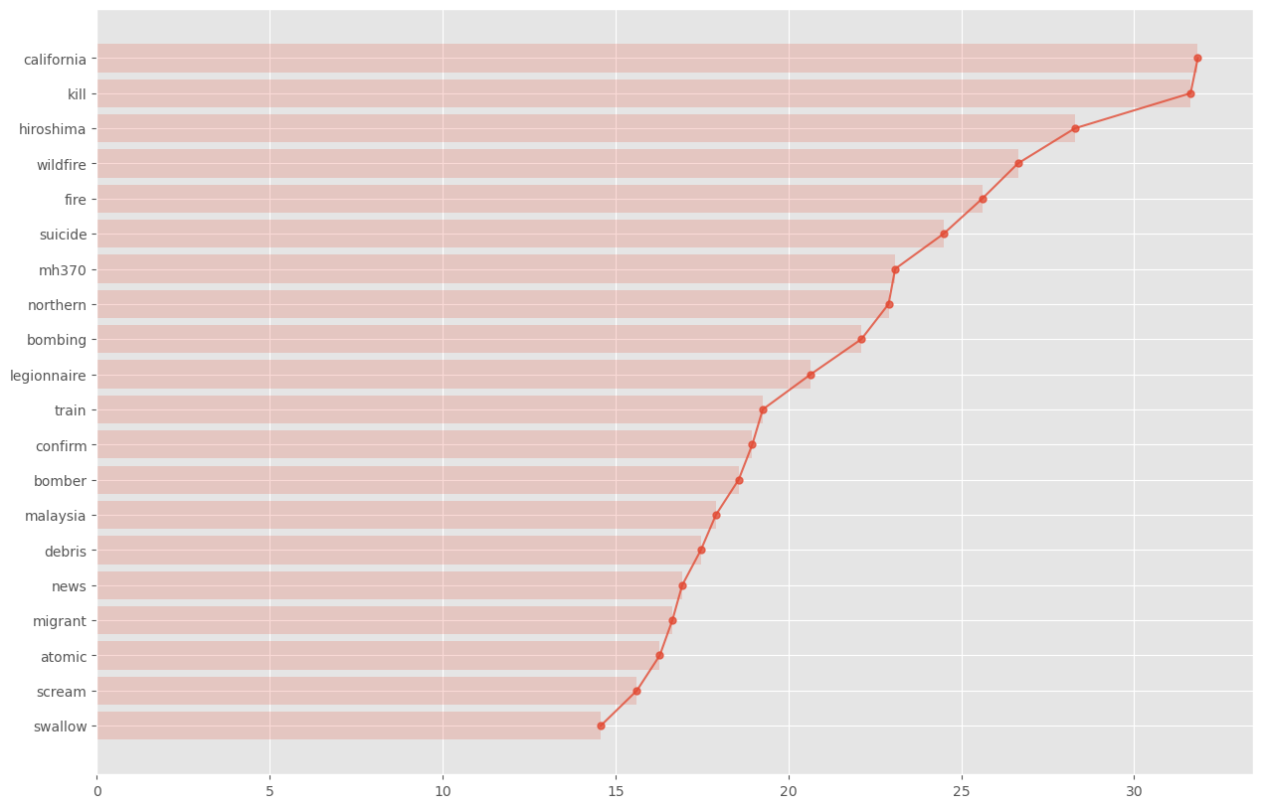
Feature Selection
Use of the chi2 feature selection model to rank features based on how indicative they are for a class.
In an additional execution, bigrams only managed to get two positions in the top 20 chart of chi2. This shows once again the relevance of unigrams.

Slide 19
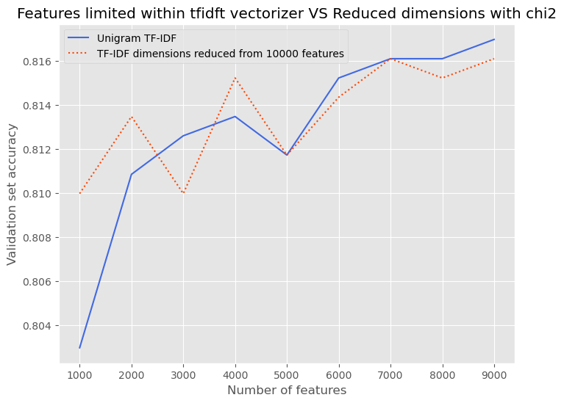
Feature Selection (2)
Compare the validation accuracy at the same number of features 1) when the number of features has been limited from Tfidf vectorizing stage, 2) when the number of features has been reduced using chi2
Best result are gained when we limit the number of features from TFIDF vectorizing and use all the features(default option)
After looking at these results we decided no to use any further future selection in our project.

Slide 20
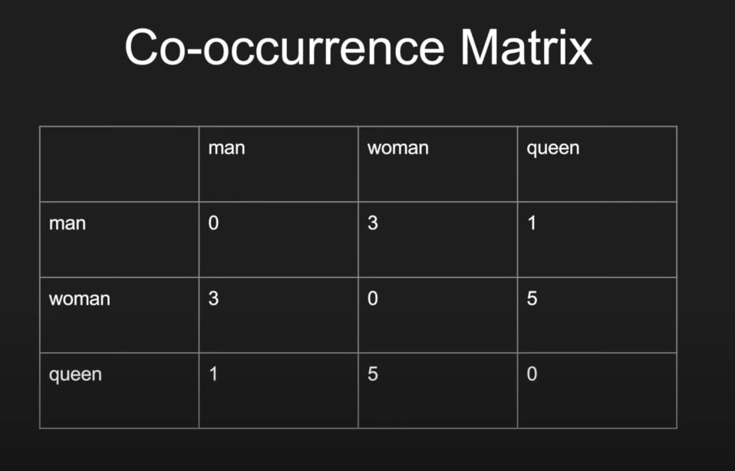
GloVe (A different Approach)
GloVe (Global Vectors) is a model that was pre-trained on a very large corpus of tweets and provides embeddings that map words that are similar close to each other. More specifically, a huge set of tweets was iterated and each time a pair of words occurred in a tweet the corresponding cell in the co-occurrence matrix was updated. The word vectors returned is the object matrix of the GloVe model. Helps us capture the semantic meaning of words(Twitter corpus -> 2B tweets, 27B tokens). No need for data preprocessing!

Slide 21
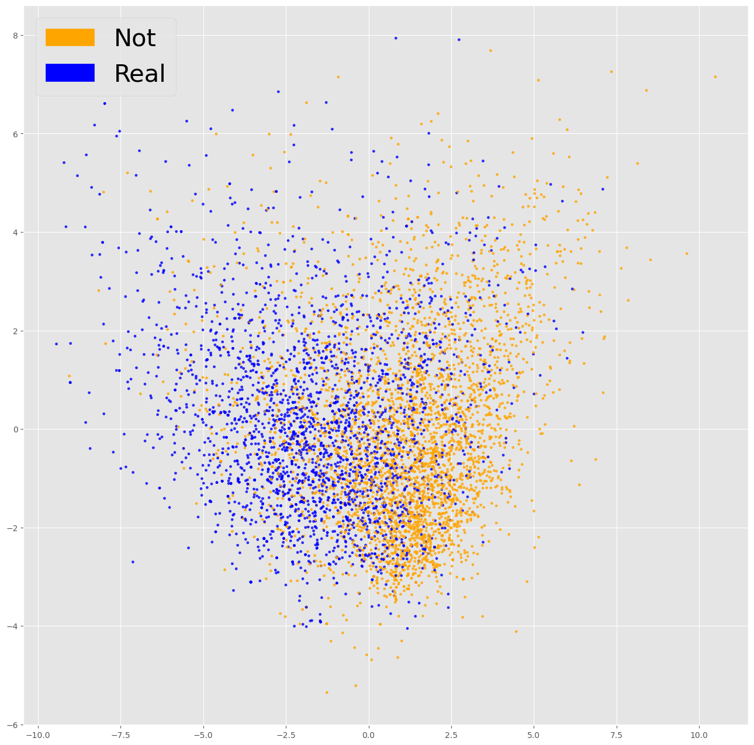
LSA on GloVe

Slide 22
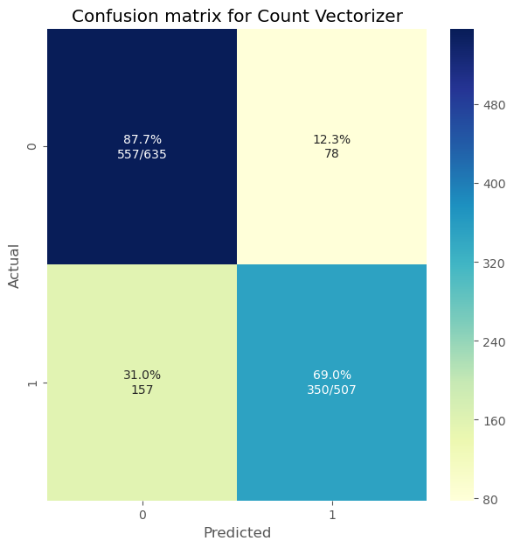


Confusion Matrices

Slide 23
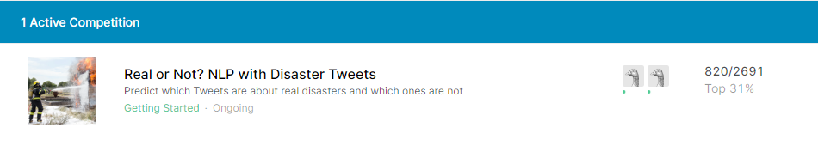
Competition Scores
After coming to our final model shape, we decided to continue and register a submission on the online competition on Kaggle.
Final F1 score : 81.49% (top 31%). The best non-cheater score was around 85%.

Slide 24
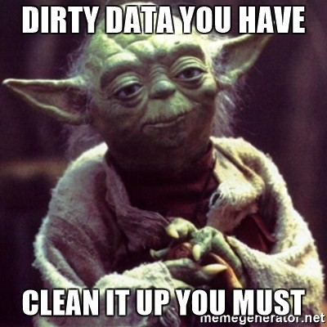
THANK YOU FOR YOUR TIME !

